Slide 1
Analysis of Seoul public transportation usage
Final Project Presentations
team: 민트초코
2017038023 반예린
2015023025 배나영
2018038003 엄은지

Slide 2
Contents
Team members and roles of each member
Project Introduction
Introduction to dataset
Optimization
Query
Visualization
Demo

Slide 3
Team members and roles of each member
반예린
Collecting Data
Create queries and visualize data
-About the number of people ride and alight the bus by time/route/station
-About the number of people ride and alight the subway by time
Bus Data Optimization
배나영
Collecting Data
Create queries and visualize data
-About the number of people ride and alight the subway by line/station
Subway Data Optimization
엄은지
Collecting Data

Slide 4

Project Introduction
About Topic
Development Environment
Python, PyCharm, MongoDB, GitHub
Seoul Bus Data
Seoul Public Transportation Usage Analysis
Query & Visualization
Seoul Subway Data

Slide 5
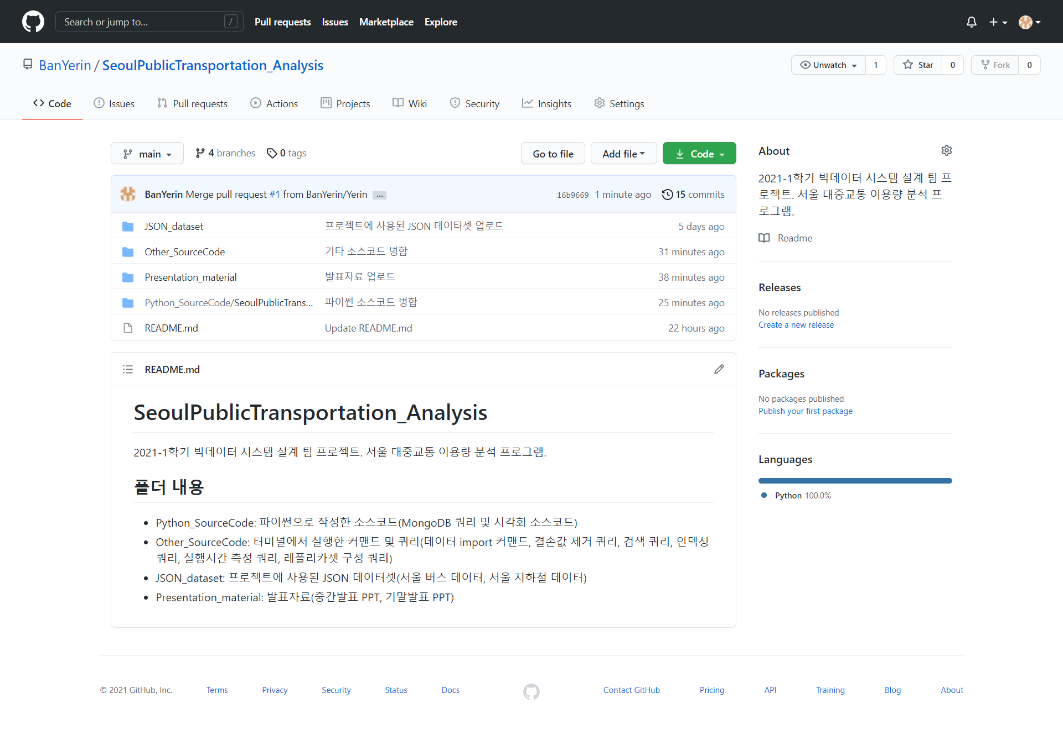
Project Introduction
Project Management
https://github.com/BanYerin/SeoulPublicTransportation_Analysis
Seoul Bus Data
Seoul Subway Data

Slide 6
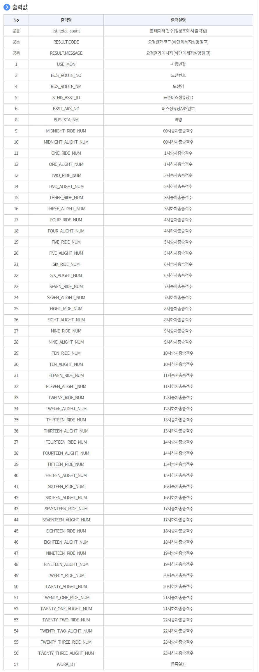
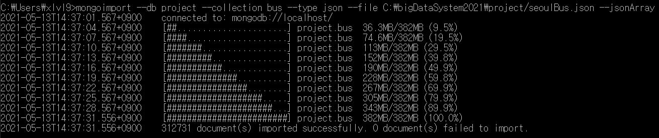
Introduction to dataset
Seoul bus data: The number of people ride and alight the bus by time/route/station
(2020. 9. 3 ~ 2021. 5. 3)

Slide 7
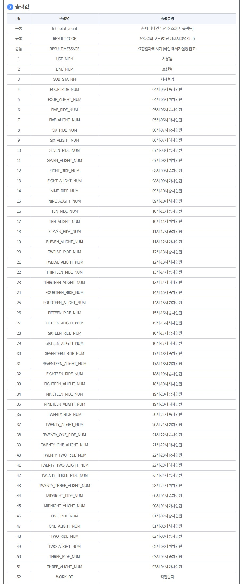
Introduction to dataset
Seoul subway data: The number of people ride and alight the bus by time/line/station
(2015. 12. 23 ~ 2021. 5. 3)

Slide 8
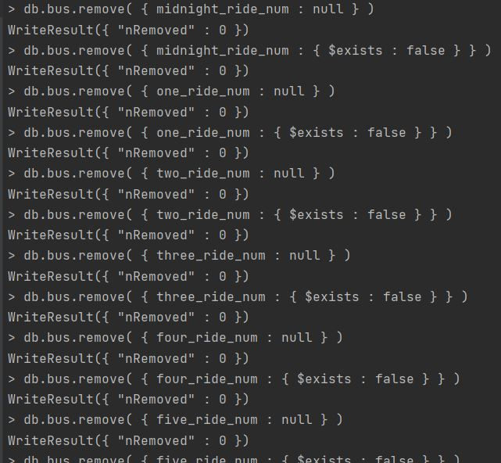
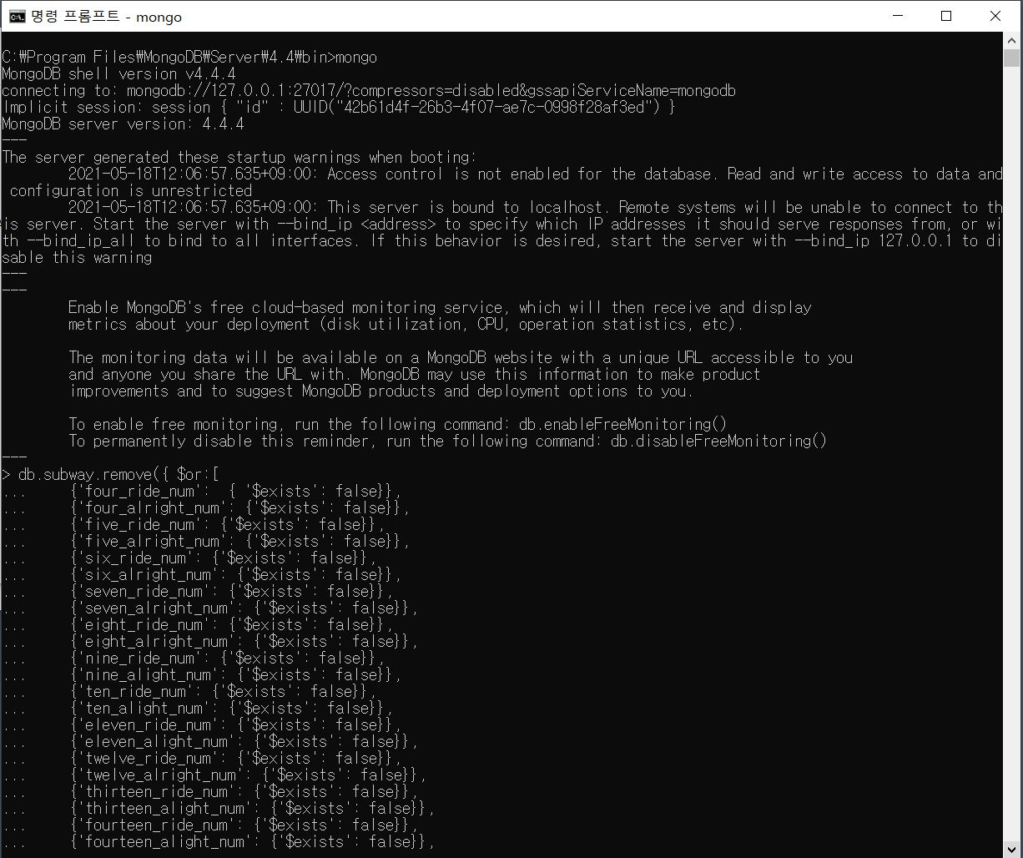
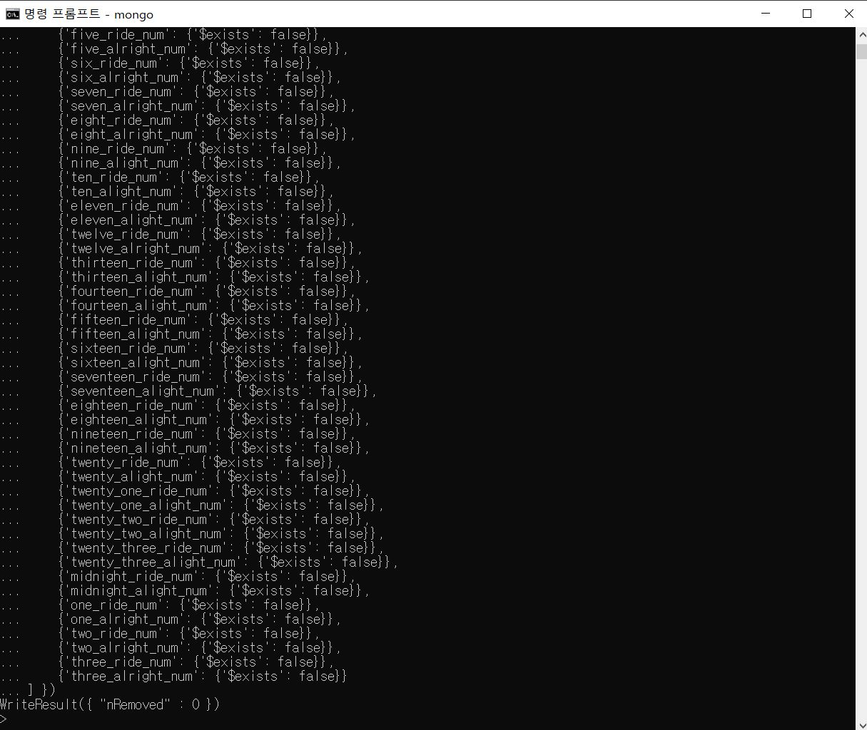
Introduction to dataset
Deletion of Missing value
. . .
. . .

Slide 9
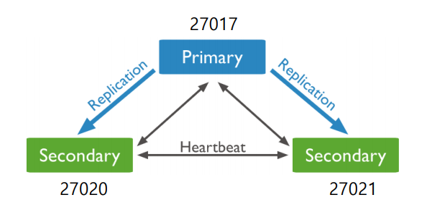
Optimization
Indexing
Bus Data Indexing: About bus_route_no(route num), bus_sta_nm(station name) Field
Subway Data Indexing : About sub_sta_nm(station name), line_num(line name) Field
Replication

Slide 10
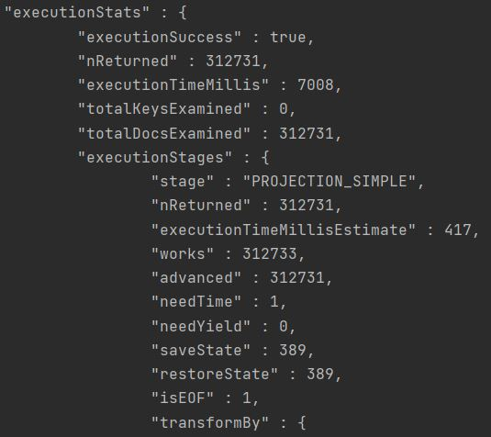
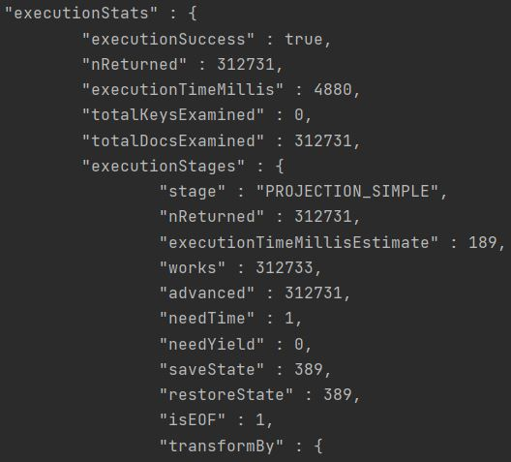
Optimization
Indexing
The number of people ride the bus by station
Before Indexing
After Indexing

Slide 11
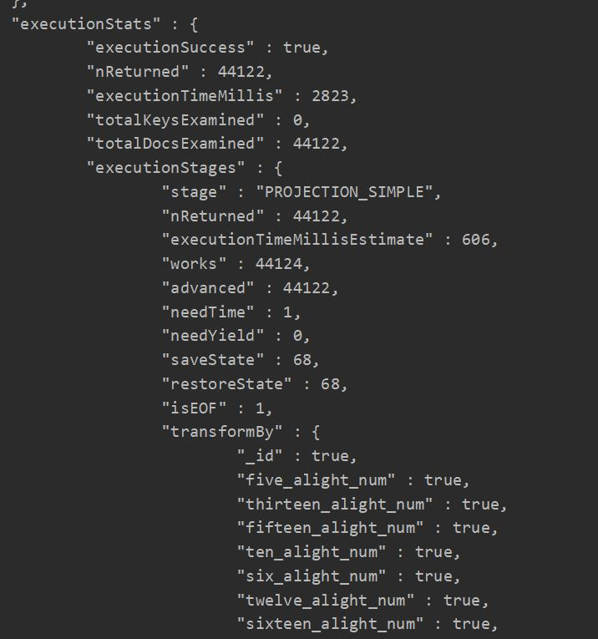
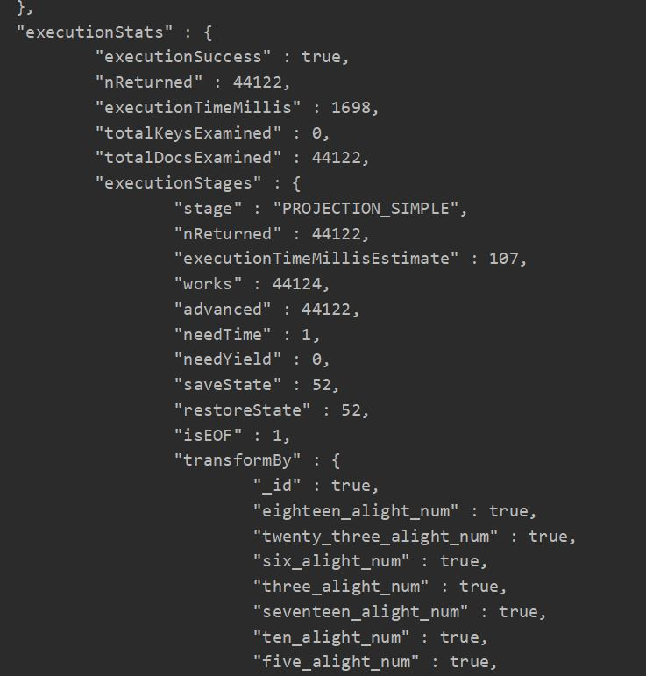
Optimization
Indexing
The number of people alight the subway by station
Before Indexing
After Indexing

Slide 12
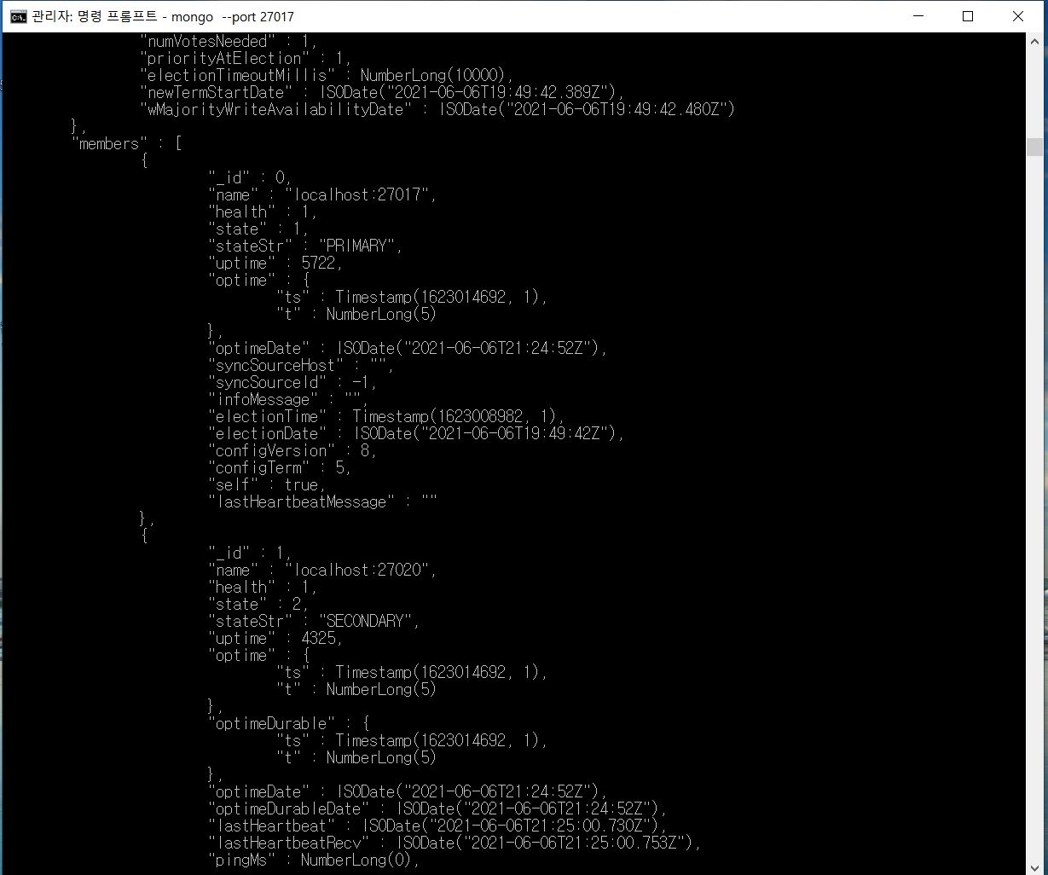
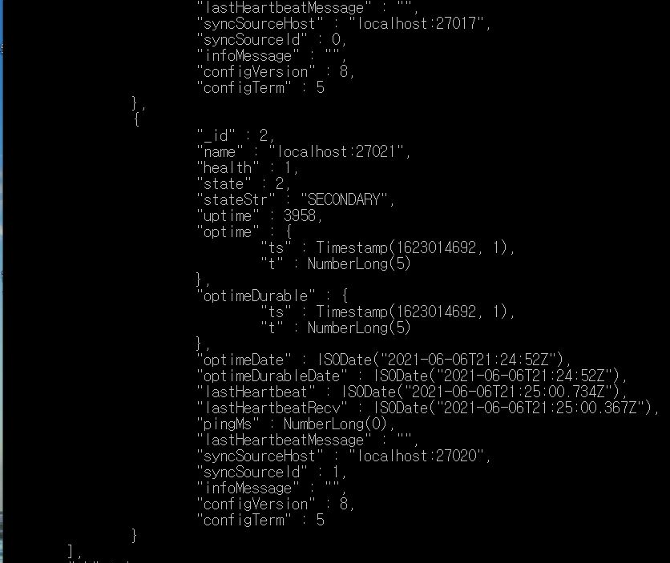
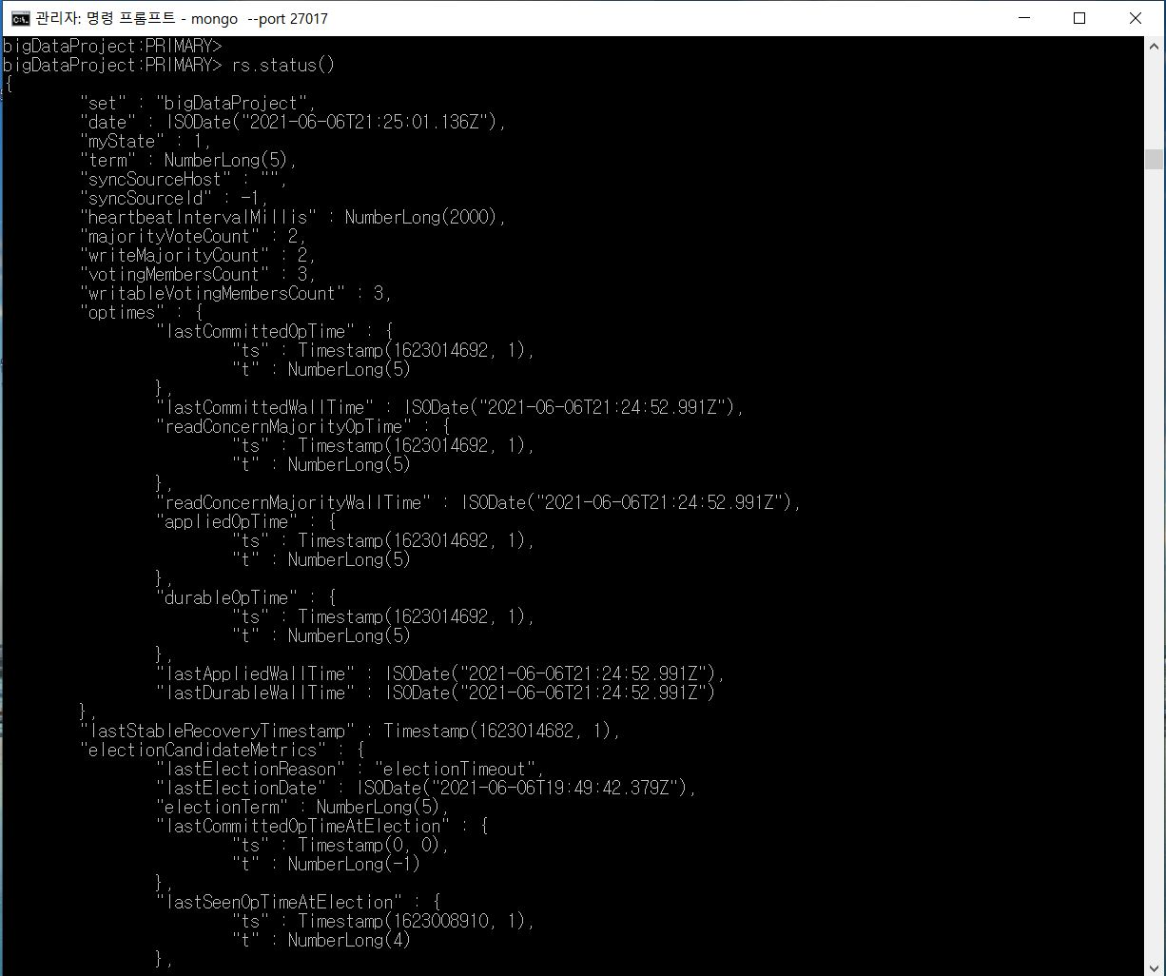
Optimization
Replication

Slide 13
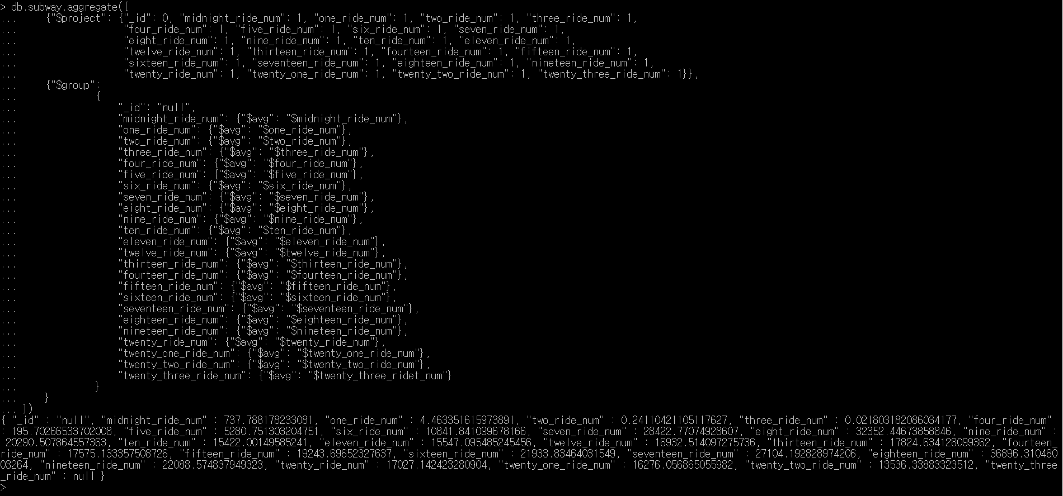
Query
Seoul subway data: The average number of people ride the subway by time per day

Slide 14
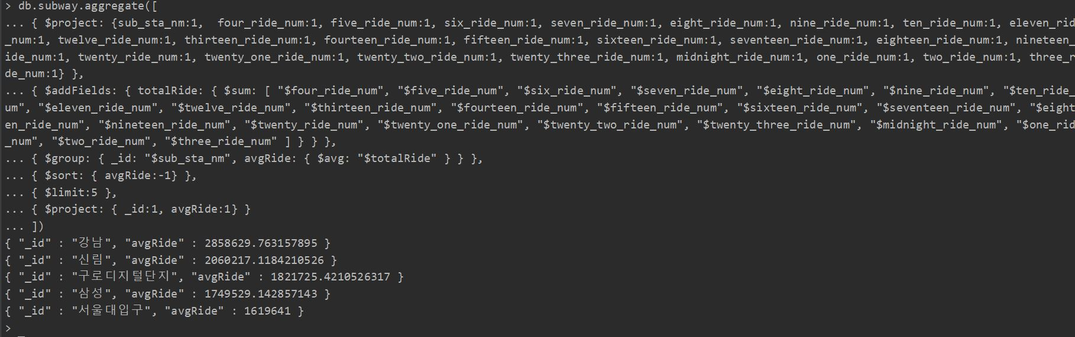
Query
Seoul subway data: The average number of people ride the subway by station per day

Slide 15
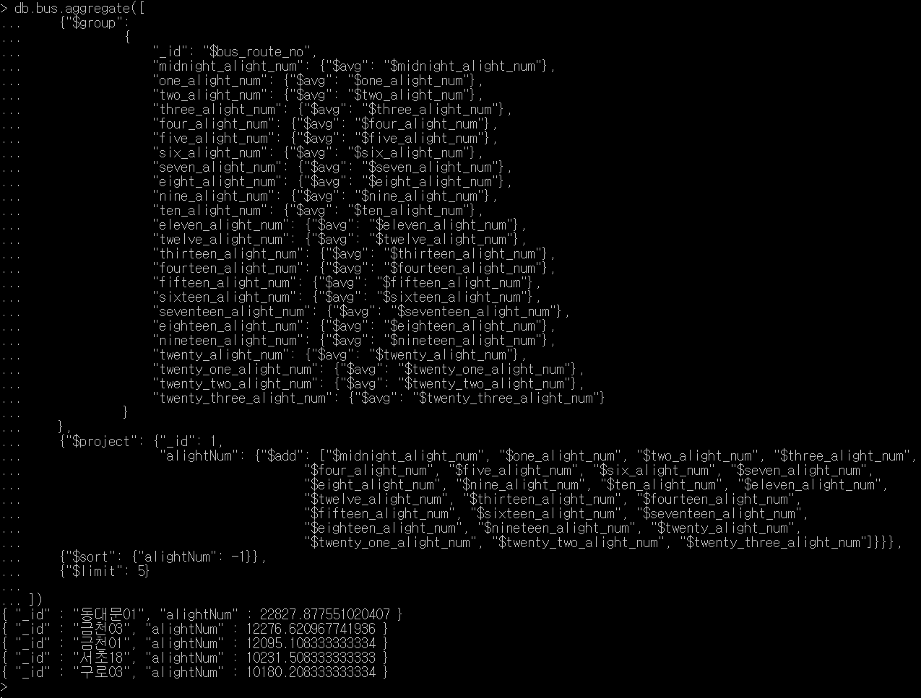
Query
Seoul bus data: The average number of people alight the bus by route per day

Slide 16
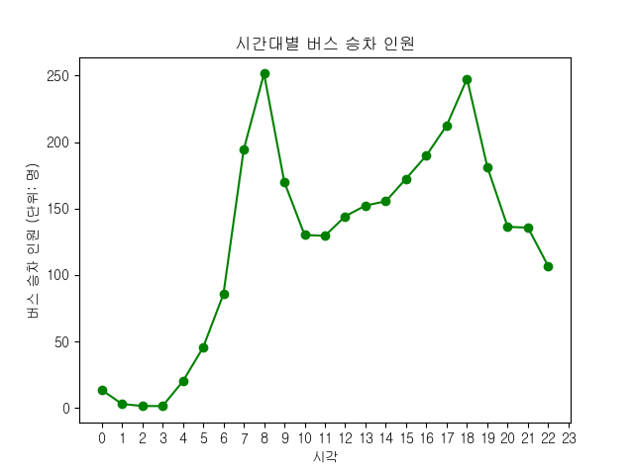
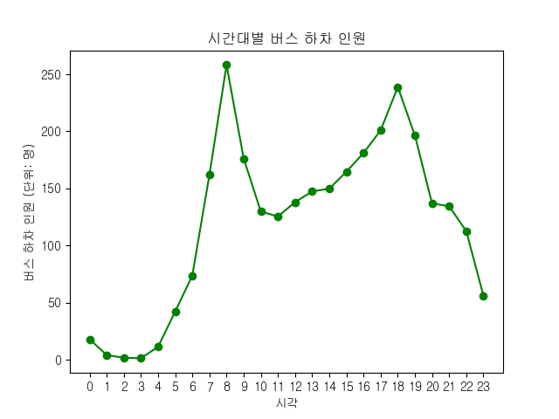
Visualization
Seoul bus data: The average number of people ride and alight the bus by time per day
8 AM
6 PM
8 AM
6 PM

Slide 17
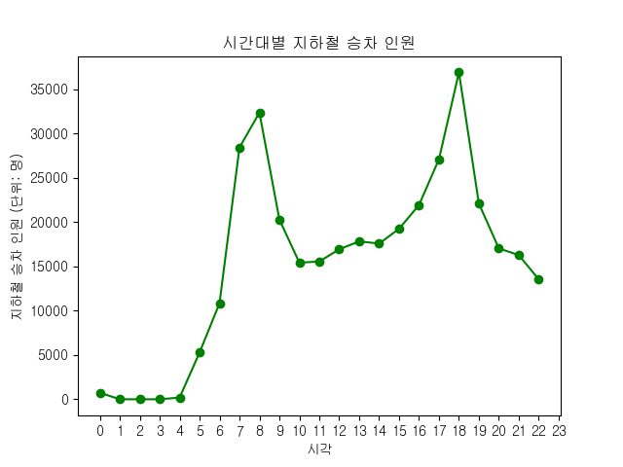
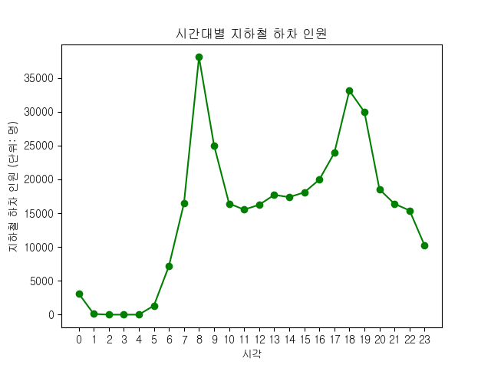
Visualization
Seoul subway data: The average number of people ride and alight the subway by time per day
8 AM
6 PM
8 AM
6 PM

Slide 18
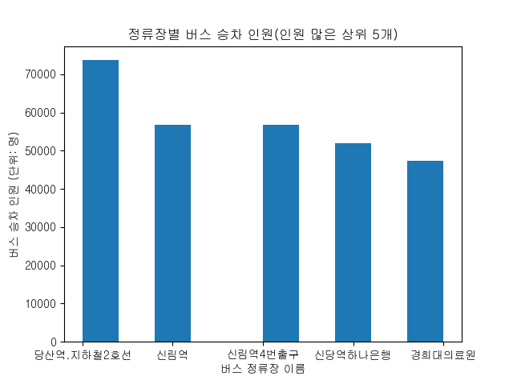
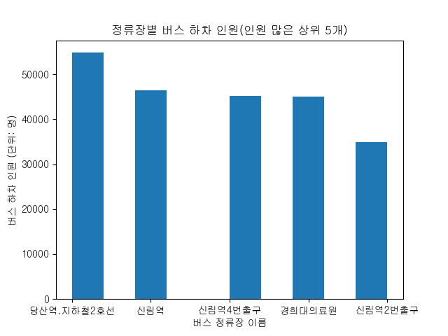
Visualization
Seoul bus data: The average number of people ride and alight the bus by station per day

Slide 19
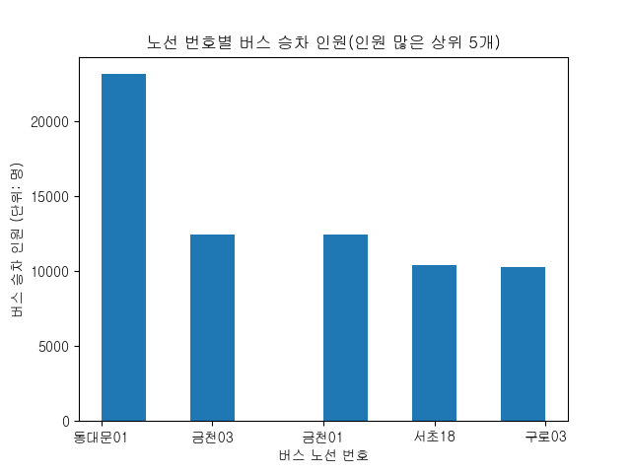

Visualization
Seoul bus data: The average number of people ride and alight the bus by route per day

Slide 20
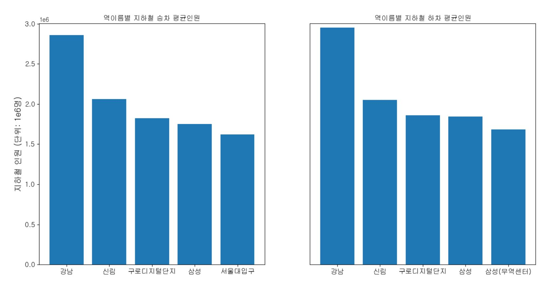
Visualization
Seoul subway data: The average number of people ride and alight the subway by station per day

Slide 21
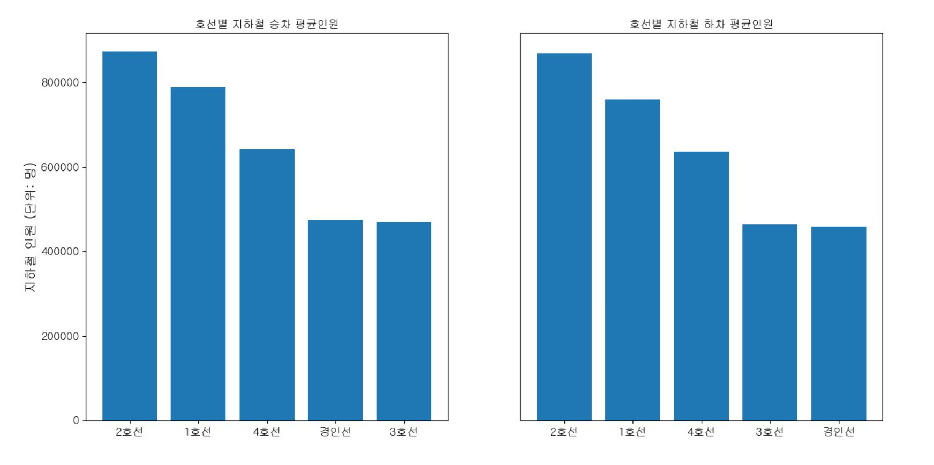
Visualization
Seoul subway data: The average number of people ride and alight the subway by line per day

Slide 22
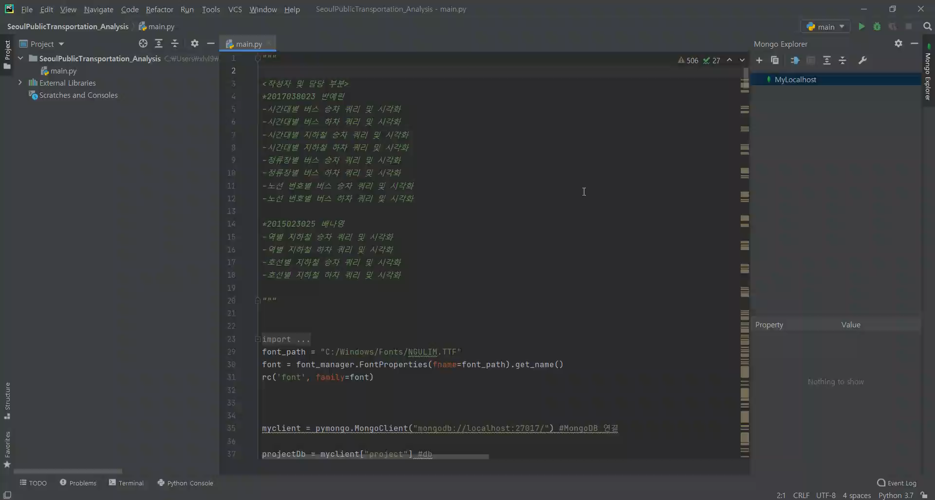
Demo

Slide 23
Thank You

